Slide 2
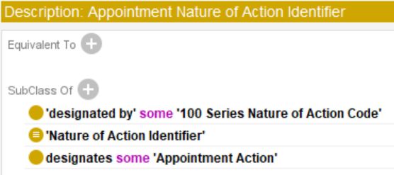
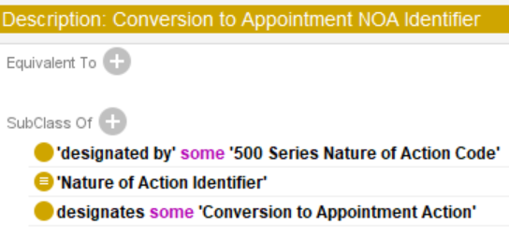
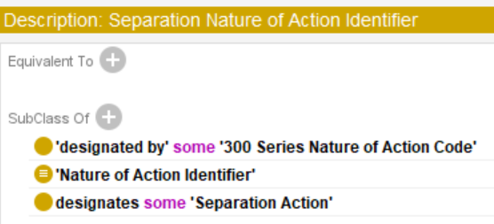

Slide 3
Personnel Action
Nature of Action Identifier
OPM Nature of Action Code
subclass of
subclass of
subclass of
Appointment Action
designates
Appointment Nature of Action Identifier
designates
100 Series Nature of Action Code
subclass of
rdf:type
rdf:type
Permanent Appointment Action
rdf:type
Nature of Action Code 100
rdf:type
subclass of
Career Appointment Identifier
designates
Nature of Action Code 142
Career Appointment Action
designates
designated by
Senior Executive Service Career Appointment Identifier
subclass of
Competitive Service Career Appointment Action
rdf:type
Competitive Service Career Appointment Action 1
designated by
subclass of
Senior Executive Service Career Appointment Action
rdf:type
Senior Executive Service Career Appointment Action 1

Slide 4
Personnel Action
Nature of Action Identifier
OPM Nature of Action Code
subclass of
subclass of
subclass of
Separation Action
designates
Separation Nature of Action Identifier
designates
300 Series Nature of Action Code
subclass of
rdf:type
rdf:type
Removal Action
rdf:type
Nature of Action Code 330
rdf:type
subclass of
designates
Removal Identifier
Retirement Separation Action
Nature of Action Code 302
rdf:type
rdf:type
designated by
designates
subclass of
Removal Action 1
Nature of Action Code 302
Retirement-Voluntary Identifier
Voluntary Retirement Separation Action
rdf:type
Voluntary Retirement Separation Action 1
designates
designated by
Retirement-Mandatory Identifier
subclass of
Mandatory Retirement Separation Action
rdf:type
Mandatory Retirement Separation Action 1
designated by

Slide 5
Planned Action
Designative Information Content Entity
Code Identifier
rdfs:subClassOf
rdfs:subClassOf
rdfs:subClassOf
rdfs:subClassOf
Personnel Action
designates
Nature of Action Identifier
designates
Nature of Action Code
rdfs:subClassOf
rdf:type
rdf:type
Competitive Service Career Appointment Action
Career Appointment Identifier
designates
Nature of Action Code 100
rdf:type
designates
Appointment Action 1

